Slide 1
Data warehouse
Schema Models

Slide 2

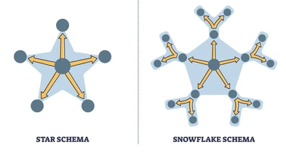

Star
❄ Snowflake
are two schemas commonly used data warehouse schema models.
Both organize data into fact and dimension tables but differ in structure and normalization levels.

Slide 3
Structure
Star Schema:
Central fact table connected to dimension tables directly.
Dimension tables are denormalized (contain redundant data).
Simple and faster for querying.
Snowflake Schema:
Central fact table connected to normalized dimension tables.
Dimension tables are split into multiple related tables (sub-dimensions).
More complex and slower for querying but saves storage.

Slide 4
More Details
Normalization Level
Star Schema: Low normalization (typically 1NF or 2NF).
Snowflake Schema: High normalization (typically 3NF).
Query Performance
Star Schema: Faster due to simpler joins and fewer tables.
Snowflake Schema: Slower due to multiple joins from normalized tables.
Maintenance
Star Schema: Easier to maintain and understand due to its simple structure.
Snowflake Schema: Harder to maintain because of complex relationships.
Storage Space
Star Schema: Consumes more space due to data redundancy.
Snowflake Schema: Consumes less space due to normalized tables and reduced redundancy.
Use Cases
Star Schema: Suitable for simple queries and quick reporting (e.g., dashboards, ad-hoc reports).
Snowflake Schema: Suitable for complex queries, large datasets, and analytical processing.
Normalization in databases is the process of organizing data to eliminate redundancy and ensure data integrity.

Slide 5
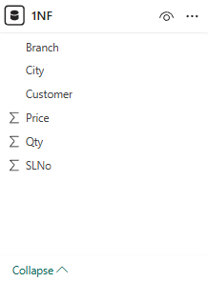
Normal forms – 1nf / 2nf / 3nf
1 NF
SLNo | Customer | Branch | City | Qty | Price
1 | Iqbal | Marina Beach | Chennai | 41 | 39
2 | John | Marina Beach | Chennai | 32 | 30
3 | John | Marina Beach | Chennai | 32 | 44
4 | John | Koramangala | Bangalore | 38 | 39
5 | Kanhai | ISBT | New Delhi | 35 | 48
6 | Iqbal | Koramangala | Bangalore | 40 | 38
7 | Iqbal | Koramanagla | Bangalore | 43 | 50
8 | Kanhai | Jayanagar | Bangalore | 35 | 39
9 | John | ChandniChowk | New Delhi | 44 | 33
10 | Iqbal | Jayanagar | Bangalore | 50 | 37

Slide 6
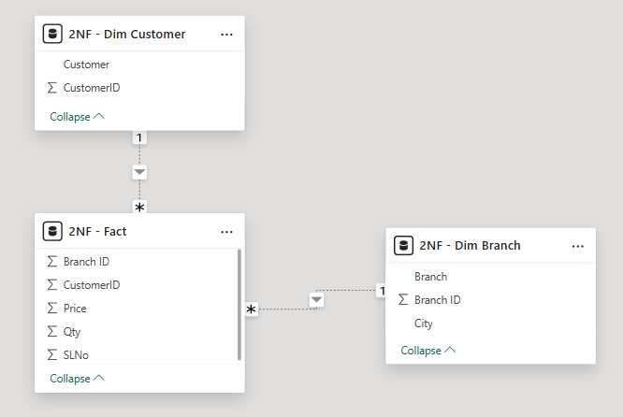
Normal forms – 1nf / 2nf / 3nf
2 NF
SL No | Cust ID | Branch ID | Qty | Price
1 | 1 | 1 | 41 | 39
2 | 2 | 1 | 32 | 30
3 | 2 | 1 | 32 | 44
4 | 2 | 2 | 38 | 39
5 | 3 | 3 | 35 | 48
6 | 1 | 3 | 40 | 38
7 | 1 | 3 | 43 | 50
8 | 3 | 4 | 35 | 39
9 | 2 | 5 | 44 | 33
10 | 1 | 3 | 50 | 37
Cust ID | Customer
1 | Iqbal
2 | John
3 | Kanhai
CUSTOMERID
Branch ID | Branch | City
1 | Marina Beach | Chennai
2 | Koramangala | Bangalore
3 | ISBT | New Delhi
4 | Jayanagar | Bangalore
5 | Chandni Chowk | New Delhi
BRANCH ID

Slide 7
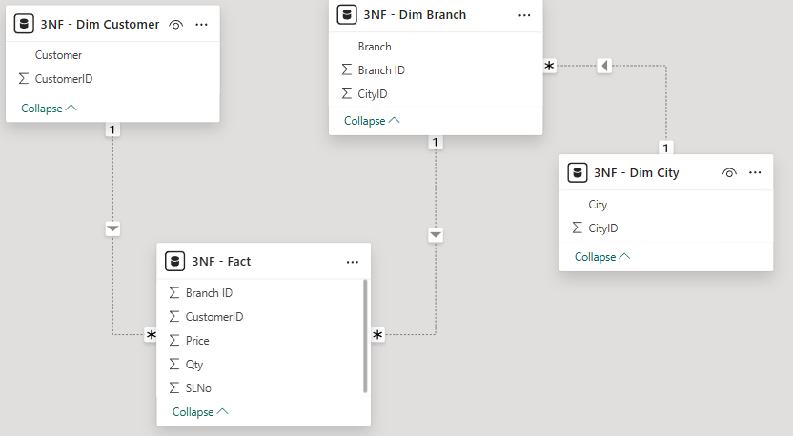
Normal forms – 1nf / 2nf / 3nf
SL No | Cust ID | BranchID | Qty | Price
1 | 1 | 1 | 41 | 39
2 | 2 | 1 | 32 | 30
3 | 2 | 1 | 32 | 44
4 | 2 | 2 | 38 | 39
5 | 3 | 3 | 35 | 48
6 | 1 | 3 | 40 | 38
7 | 1 | 3 | 43 | 50
8 | 3 | 4 | 35 | 39
9 | 2 | 5 | 44 | 33
10 | 1 | 3 | 50 | 37
Cust ID | Customer
1 | Iqbal
2 | John
3 | Kanhai
1 NF
Branch ID | Branch | City ID
1 | Marina Beach | 1
2 | Koramangala | 2
3 | ISBT | 3
4 | Jayanagar | 2
5 | Chandni Chowk | 3
City ID | Customer
1 | Chennai
2 | Bangalore
3 | New Delhi

Slide 8
Summary
Aspect | Star Schema | Snowflake Schema
Structure | Central fact with flat dimensions | Central fact with normalized dimensions
Normalization | Low (denormalized) | High (normalized)
Query Performance | Fast (fewer joins) | Slower (multiple joins)
Maintenance | Easy | Complex
Storage | More (due to redundancy) | Less (due to normalization)
Best for | Simple reporting, OLAP | Complex analytics, large databases

